Slide 1
COVID-19 Pandemic: Global Insights Exploring the spread, impact and trends.
Notes:
Welcome everyone. Today we will be exploring the global impact and trends of the COVID-19 Pandemic.

Slide 2
169,065,144
3,647,894
113,089,548
22.01.2020 - 13.06.2021
Confirmed Cases
Deaths
Recovered
Notes:
Here's a brief overview of the pandemic's global impact.

Slide 3
Pandemic Progression
169M
113M
3.6M
Notes:
Let's take a look at how the pandemic has progressed over time.

Slide 4
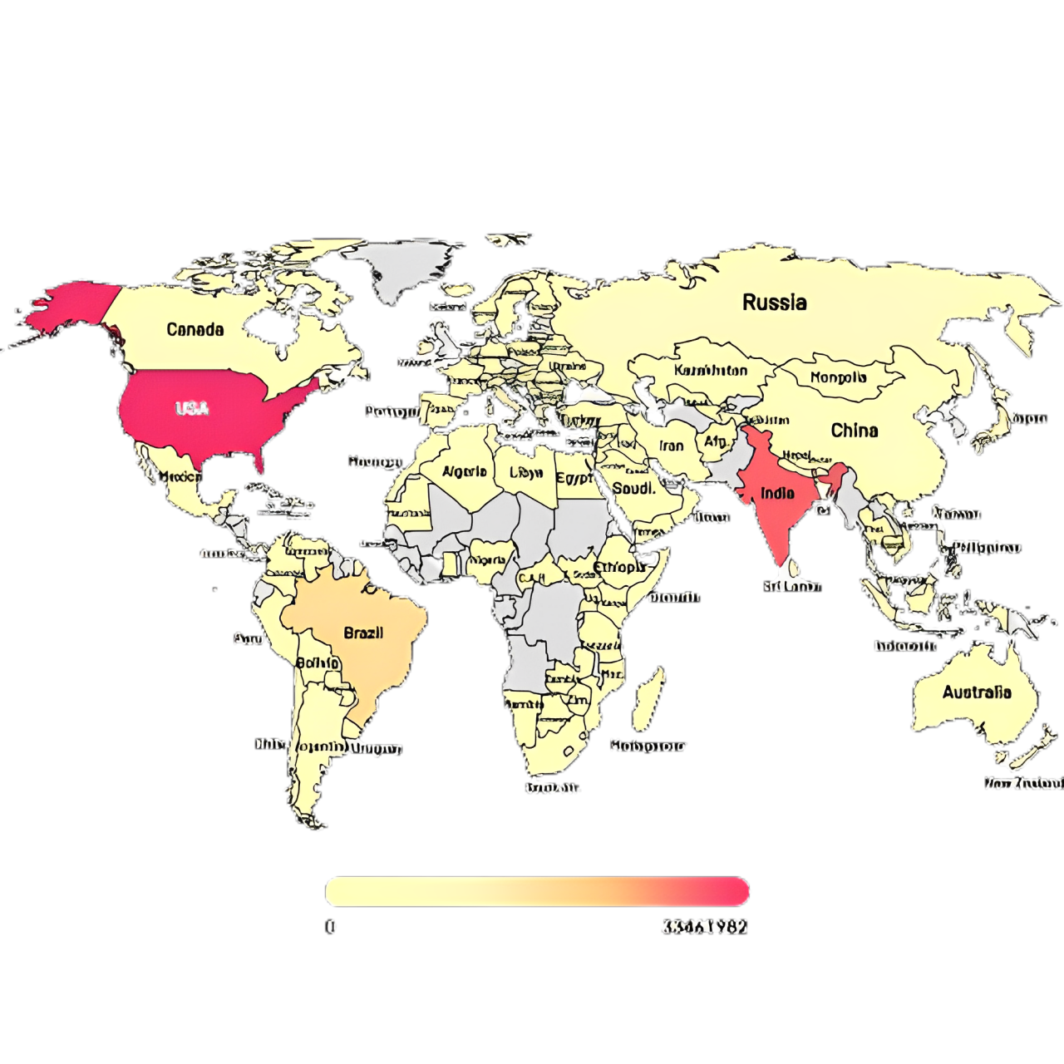
Confirmed Cases Globally
Notes:
Now, let's examine the pandemic's spread across regions. The Spread is more or less even with spikes in the USA and India.

Slide 5
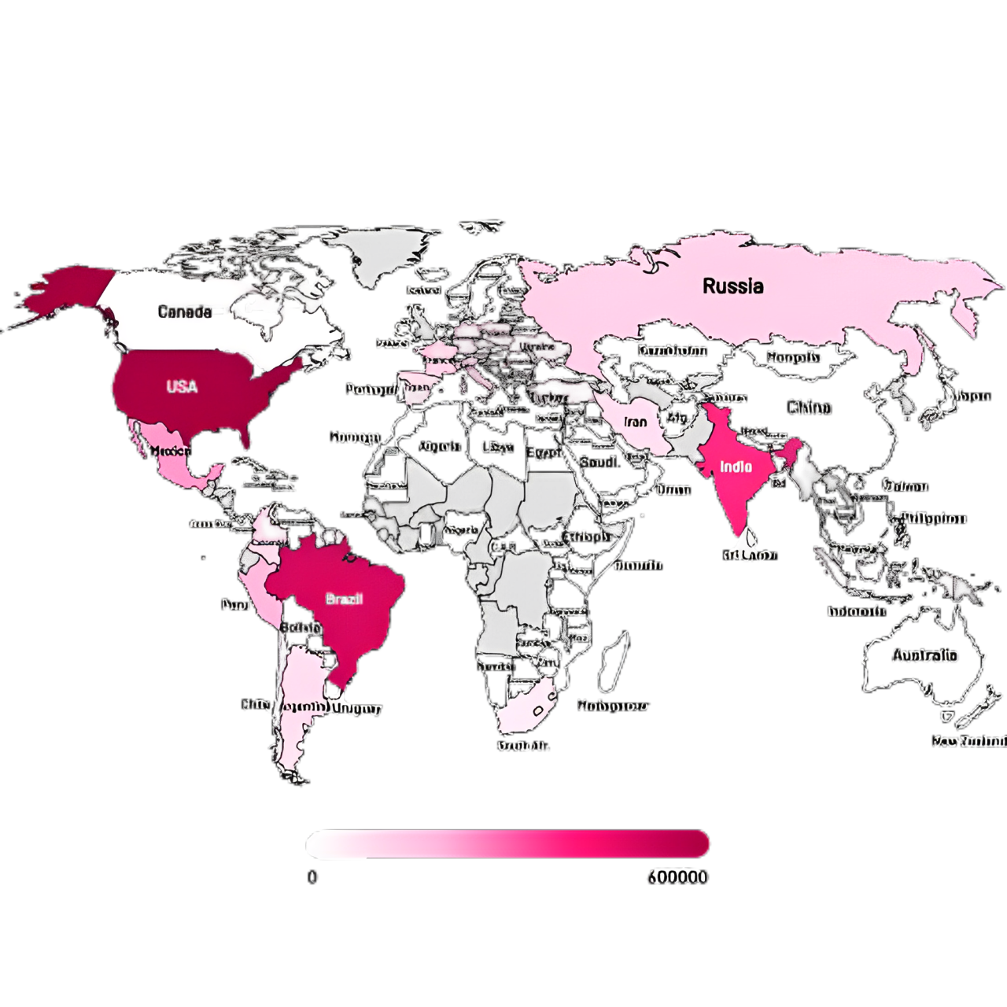
Deaths Globally
Notes:
Lots of people lost their lives and loved ones to the virus. Nations that suffered from the most losses include the USA, Brazil and India.

Slide 6
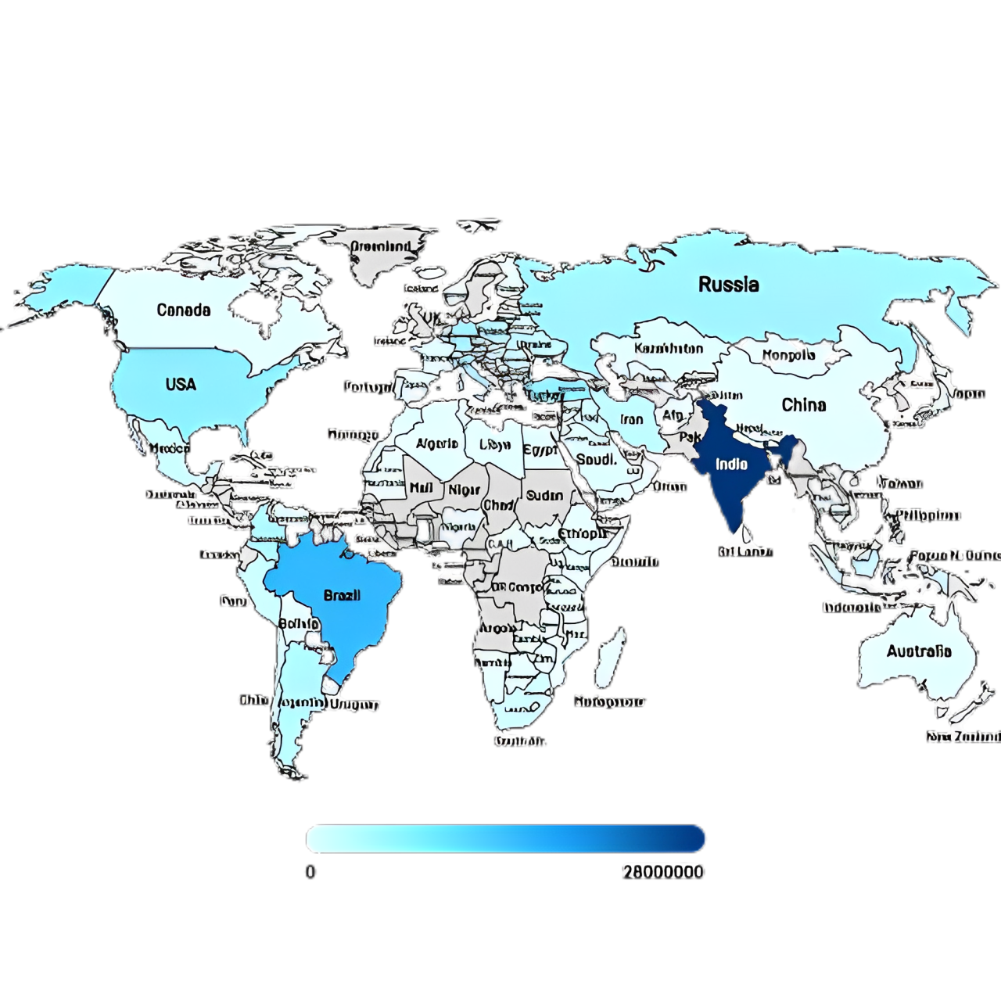
Recoveries Globally
Notes:
Grateful, there have been a lot of recoveries around the world. Countries like Brazil and India celebrate a larger number of these stats.

Slide 7
Top Affected Countries
Confirmed Cases
Recorded Deaths
Recovered
USA | 33461982
India | 29460523
Brazil | 17412766
France | 6106009
Turkey | 5330447
USA | 599769
Brazil | 487401
India | 370730
Mexico | 230150
Peru | 188708
India | 28089649
Brazil | 15400169
USA | 6303715
Turkey | 5202251
Russia | 4745756
Notes:
Let’s dive deeper into Country-wise Insights. Here we have a list of countries that experienced the most of the effects of the Pandemic.

Slide 8
Infection Growth Rate
Notes:
The growing infection seemed to reduce at some point around February in ‘21, but immediately starts heading for an all-time by April.

Slide 9
Mortality Rate
Notes:
It was sad to see this virus take more, and more lives over time.

Slide 10
Recovery Rate
Notes:
Gratefully, we continued to see a growing number of those who recovered from the virus as well. Mitigation and Prevention measures working more over time.

Slide 11
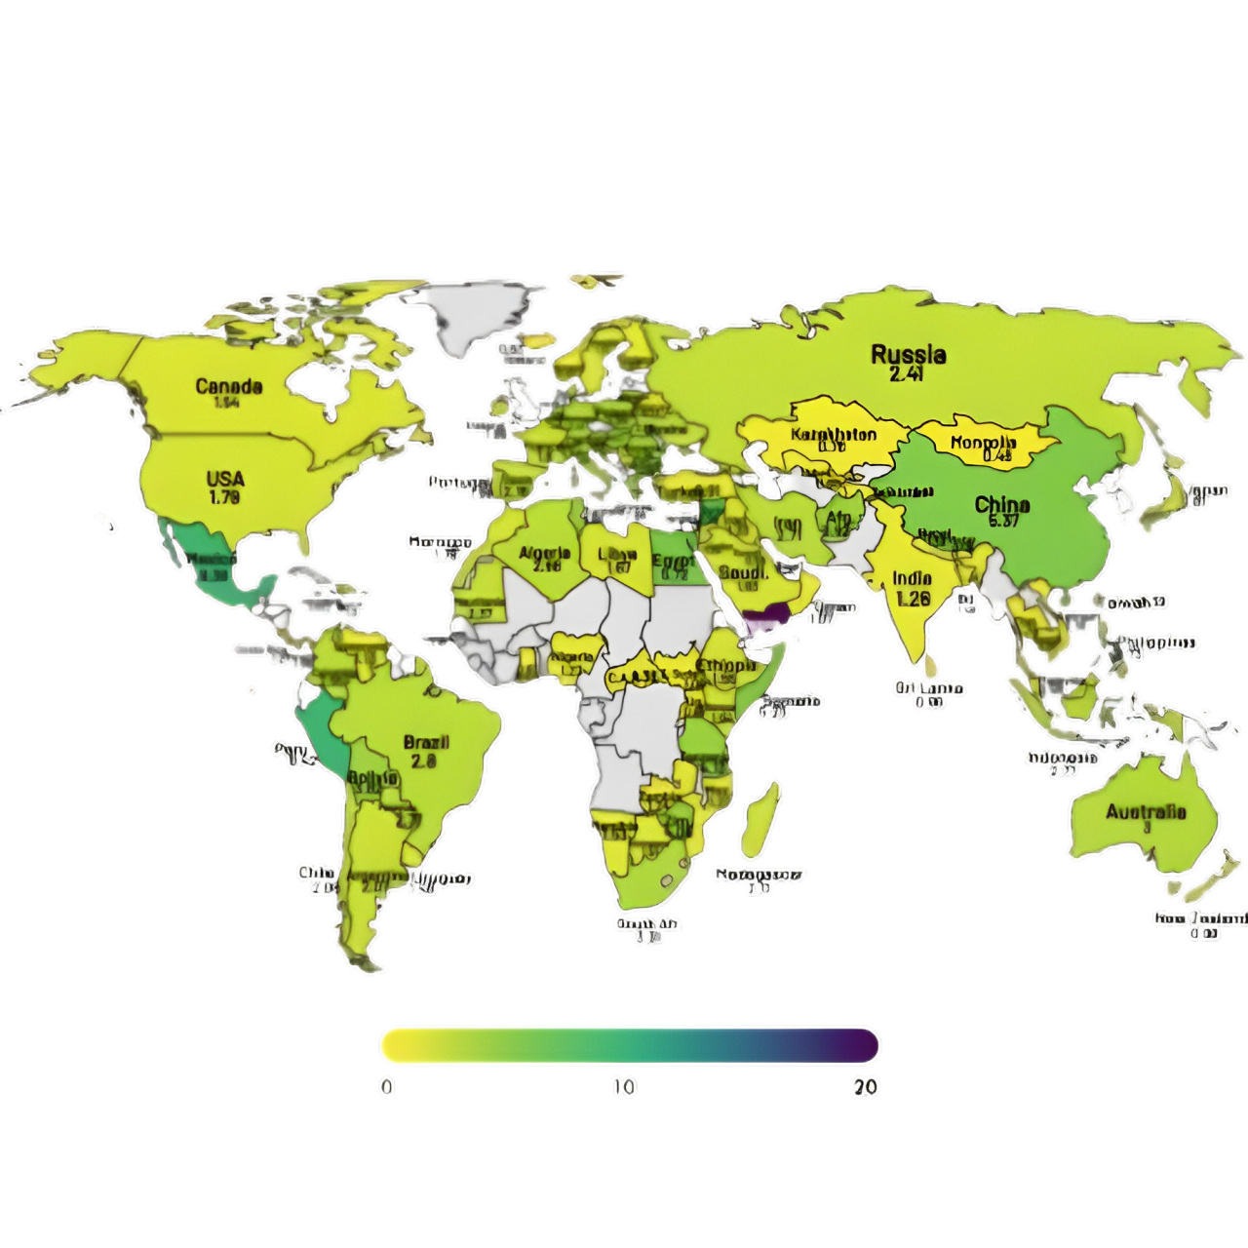
Case Fatality Rate (CFR) % Death of Confirmed Cases
Notes:
Countries recorded low Case Fatalities, with the highest percentage at 19.66 in Yemen.

Slide 12
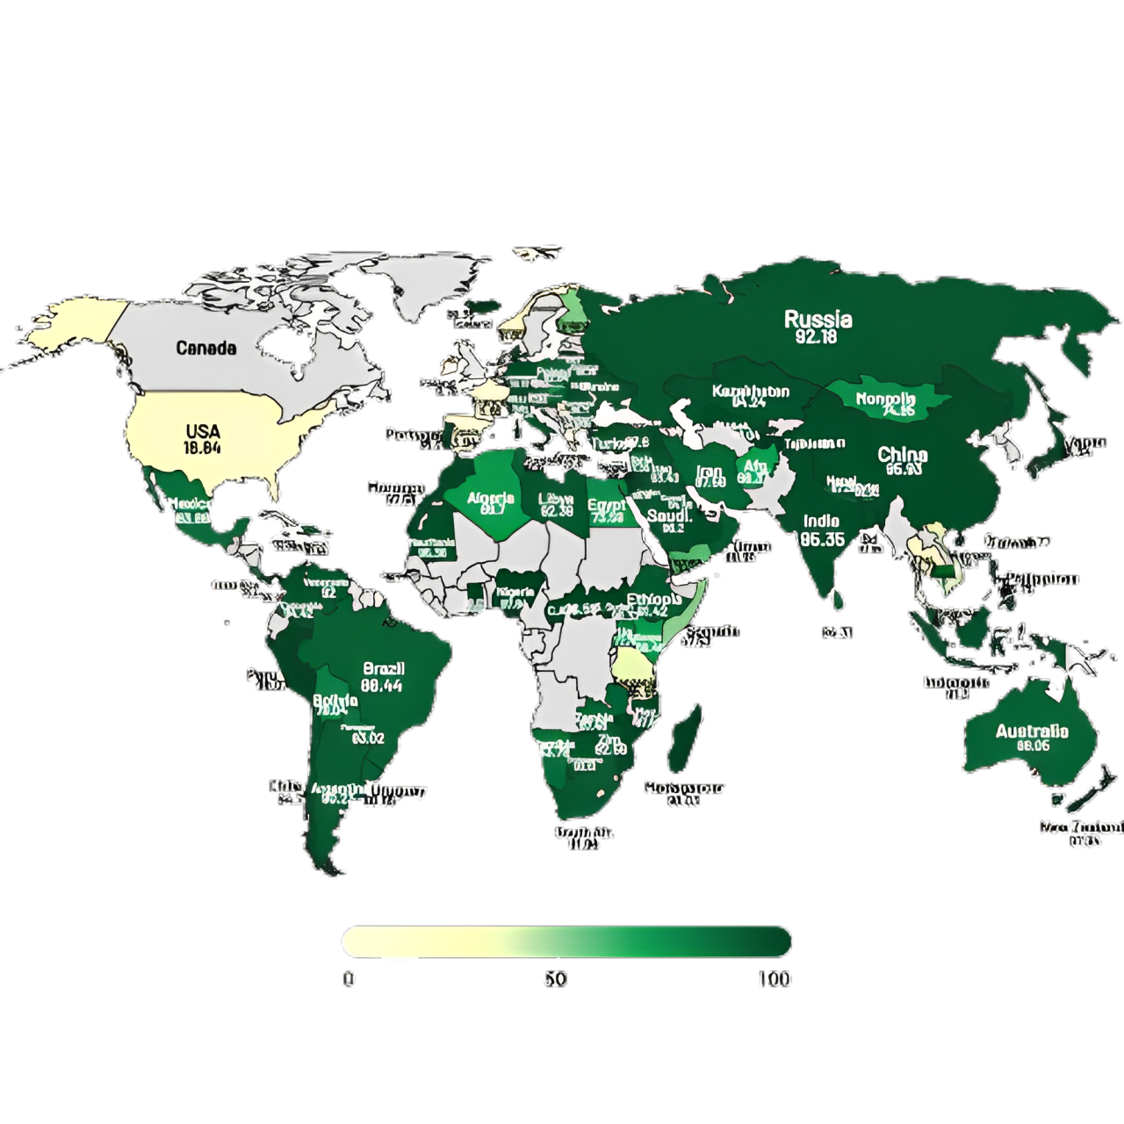
Recovery Percentage % Recovered of Confirmed Cases
Notes:
A larger percentage recovered from the virus, and numbers hopefully rose going forward.

Slide 13
Summary of Key Findings
01
Global Infection Rate (GIR)
2.14%
02
Global Case Fatality Rate (CFR)
2.16%
03
Global Recovery Rate (GRR)
66.89%
Time Period: 22.01.2020 - 13.06.2021
Data Source: Mentorness
Notes:
So, in summary, between January 2020 and June 2021, the world saw about 2% of its population infected with the corona virus, a bit over 2% of those infected cases led to death, but a whopping 66.9% of that Infected population were able to recover thanks to vaccinations and mitigation measures. The world hopes to never have to deal with such a pandemic ever again. Thank you.

